Slide 1
Regression in Data Analytics

Slide 2
Regression
Fairly similar to classification, however, the target to predict is of numeric types
Example:
Predict monthly product sales based on product types, categories, advertising spends, etc.
Predict first year GPA based on students’ majors and high school grades in different classes
Predict wildfire area based on location and weather
Etc.
Similar to classification, to train a regression model, the training data must include both the features and the labels
This is referred to as Supervised Learning – a branch of machine learning in which models need both features and labels to learn
StudentID | Major | HSMath | HSEnglish | HSScience
001 | IT | 3.5 | 3 | 3.4
002 | CS | 3.5 | 3.6 | 3.6
003 | IT | 3.0 | 3.1 | 2.8
004 | SWE | 2.9 | 2.8 | 2.9
005 | BIO | 3.1 | 3.2 | 3.1
FYGPA
3.2
3.7
2.9
2.9
3.2

Slide 3
Regression Models in this Module
“Models” refer to the algorithms that we will be using to solve an analytical task
Regression models are algorithms that are designed for the regression task. They are trained to map input feature data to output numerical targets
001 | IT | 3.5 | 3 | 3.4
Model
3.2
002 | CS | 3.5 | 3.6 | 3.6
Model
3.7
003 | IT | 3.0 | 3.1 | 2.8
Model
2.9

Slide 4

Linear Regression Model
Given the input data has features $x_{1},x_{2}…x_{k}$ and the target $y$, linear regression models try to estimate $y$ using the below equation
$$y=β_{0}+β_{1}x_{1}+β_{2}x_{2}+…+β_{k}x_{k}$$
$β_{0}$ is called the intercept
Other $β$’s are called coefficients
This equation is linear in terms of the input features, hence the name linear regression
$$x_{1}$$
$$x_{2}$$
$$x_{3}$$
$$x_{4}$$
$$y$$
StudentID | Major | HSMath | HSEnglish | HSScience
001 | IT | 3.5 | 3 | 3.4
002 | CS | 3.5 | 3.6 | 3.6
003 | IT | 3.0 | 3.1 | 2.8
004 | SWE | 2.9 | 2.8 | 2.9
005 | BIO | 3.1 | 3.2 | 3.1
FYGPA
3.2
3.7
2.9
2.9
3.2

Slide 5
Linear Regression Example
Return to the student GPA, we can train a linear regression in this data
The equation may look like
Then, we can “plug” the actual numbers from each student into the equation to obtain their predicted FYGPA
StudentID | Major | HSMath | HSEnglish | HSScience
001 | IT | 3.5 | 3 | 3.4
002 | CS | 3.5 | 3.6 | 3.6
003 | IT | 3.0 | 3.1 | 2.8
004 | SWE | 2.9 | 2.8 | 2.9
005 | BIO | 3.1 | 3.2 | 3.1
FYGPA
3.2
3.7
2.9
2.9
3.2
$$\hat{y}=1+0.4Math+0.25English+0.2Science$$
Prd. FYGPA
3.0
3.5
3.2
3.0
3.1

Slide 6
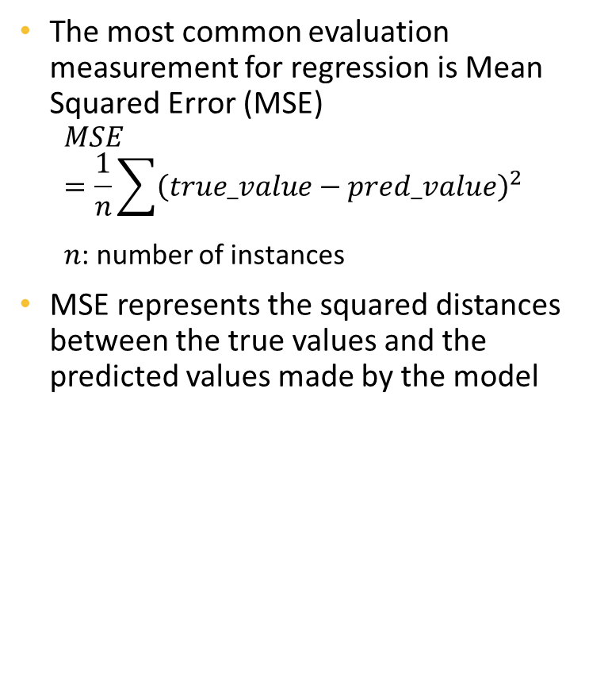
Mean Squared Error
The most common evaluation measurement for regression is Mean Squared Error (MSE)
$$MSE=\frac{1}{n}\sum{{\left(true_value−pred_value\right)}^{2}}$$
$n$: number of instances
MSE represents the squared distances between the true values and the predicted values made by the model
FYGPA
3.2
3.7
2.9
2.9
3.2
P. FYGPA
3.0
3.5
3.2
3.0
3.1
Error
0.2
0.2
-0.3
-0.1
0.1
Sq. Error
0.04
0.04
0.09
0.01
0.01
0.038
MSE

Slide 7
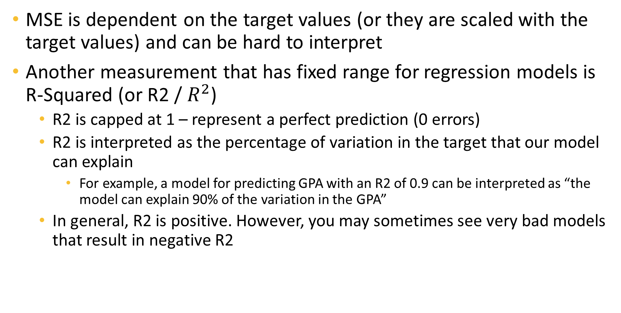
R-Squared
MSE is dependent on the target values (or they are scaled with the target values) and can be hard to interpret
Another measurement that has fixed range for regression models is R-Squared (or R2 / $R^{2}$)
R2 is capped at 1 – represent a perfect prediction (0 errors)
R2 is interpreted as the percentage of variation in the target that our model can explain
For example, a model for predicting GPA with an R2 of 0.9 can be interpreted as “the model can explain 90% of the variation in the GPA”
In general, R2 is positive. However, you may sometimes see very bad models that result in negative R2

Slide 8
Gradient Boosting Model
Fitting and selecting best tree
An ensemble of tree models similar to Random Forest
Unlike random forest, the trees are not added to the ensemble randomly but rather with an objective of minimizing the training errors
Is trained iteratively, starting from an empty ensemble
Fit many trees on the training data
Select the one with the best performance to add to the ensemble
Repeat until having the desirable number of trees
Hyperparameters: maxDepth and minInstancesPerNode
X1 | x2 | x3 | y
Iteration 1
Data
Iteration 2
Fitting and selecting best tree
Final ensemble
Iteration n
…

Slide 9
Individual Project 1
Task summary: pick a dataset and analyze it either as a classification or a regression problem in Hadoop + PySpark + Zeppelin
Dataset requirements:
Must have at least 800 rows and 8 columns
Beside the target, must have both string columns and numeric columns
Common sites to get data:
https://archive-beta.ics.uci.edu/datasets
https://www.kaggle.com/datasets
Any other sites are also okay as long as the data satisfies the requirement
What to do in terms of analyze
Load the data
Process the data to fix any issues – you can use the template
Model the data using Decision Tree, Random Forest, and Gradient Boosting
As we only discuss tree and forest for classification, and gradient boosting for regression, you need to do your own research on tree and forest for regression and gradient boosting for classification
The models should be tuned
Compare the results from the three models
Submission: your Zeppelin notebook with all codes and output populated

Slide 10
Tips
Make sure the data you downloaded is CSV with comma separator
You can do this by just opening the file in any text editor
Switching between classification and regression are fairly simple in PySpark, you just need to
Import and use the correct model class (Regressor or Classifier)
Use the correct metric for tuning (accuracy for classification, MSE or R2 for regression)
Certain models may take a long time to run. You can
Drop some values from a grid parameter
Reduce the CV fold number
I will not grade by your models’ performance, so don’t worry if you see low accuracy or low R2.
Those depend largely on the data.
As long as the analysis is correct, you will get full credit.

